Slide 1
Saint Agnes Student and Instructor Clearance Process
Fall 2026

Slide 2
Agenda
Introductions
Website Resources
Instructor & Student Clearance
EHR Access
Float Areas
Clinical Day Information

Slide 3
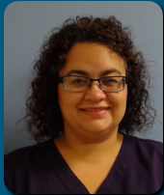
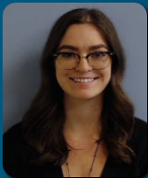
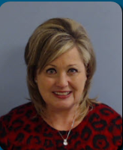
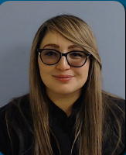
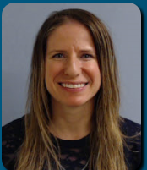
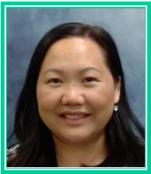
Introductions –
SAMC, Development & Support Services Team
Director – Maria Sanchez
Learning Management System Administrator – Emily Viikinsalo
Central Education Specialist – Karla Schramm
Central Education Specialist – Luz Frausto
Nurse Residency Program Coordinator – Savannah Pronovost
Administrative Assistant – Mai Chang

Slide 4
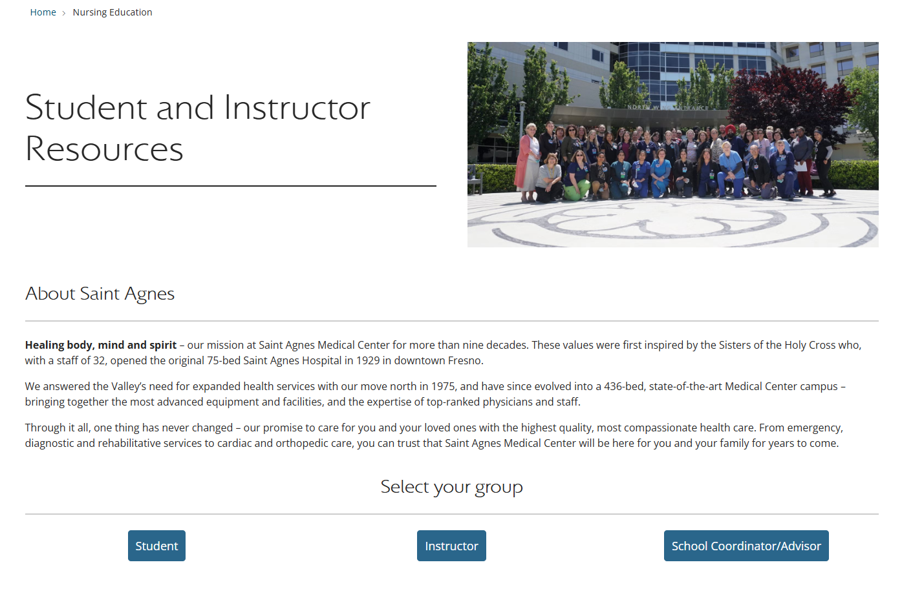
Website Resources
www.samc.com
Nursing Education | Saint Agnes Medical Center

Slide 5

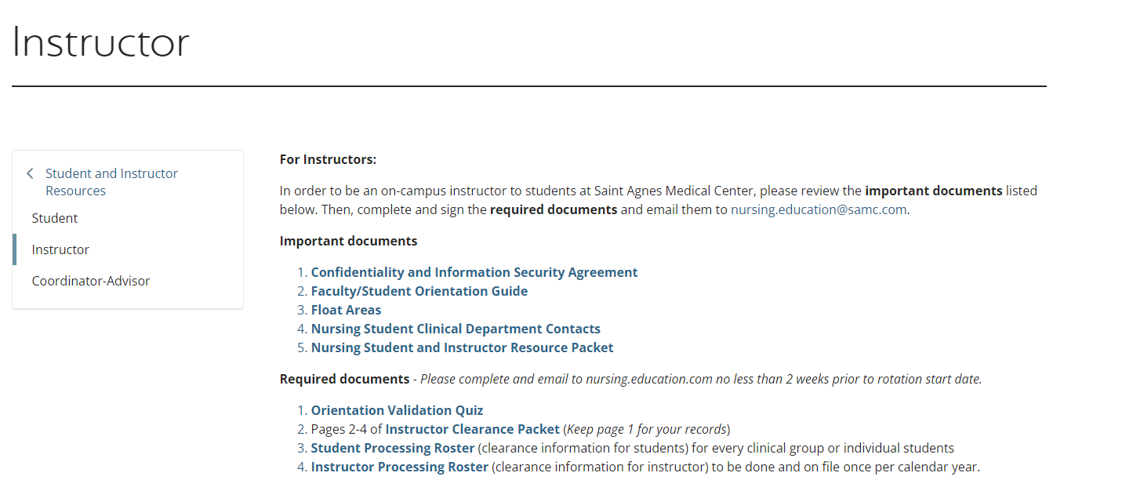
Instructor Resources Tab
Using your class time wisely will decrease the amount of work you need to complete at home.
Please record your first and last name on all of your assignments.
Completed assignments should be turned in to the tray on the table in the front of the room.
Assignments will be graded and returned to you each Friday.

Slide 6
Instructor Clearance Roster
  All requirements are listed on the SAMC website.
Instructor Roster
Required to current at all times. It is the instructor’s responsibility to submit updated TB, BLS or vaccine information to nursing.education@samc.com.
Vaccine titers to be indicated by “Date +”
Picture of BLS card required
No longer require covid vaccine documentation
Criminal Background Checks (CBC) and 10 panel drug screen are required for instructors and is good for 4 years if there is no break in course progression.
Drug screen/CBC is required annually if instructor has more than one semester break in a one-year period.
Valid for one year period
Clearances on paper is preferred

Slide 7
Instructor Clearance
Packet
  All requirements are listed on the SAMC website.
Instructor Clearance Packet
Required to submit annually in Fall semester
May resubmit same documents in subsequent semesters (Spring, Summer) so long as the information is up to date
Valid for one year period

Slide 8
Instructor Clearance:
SAMC Employees
If you are an SAMC Employee:
Instructor Roster
You will need to indicate you are a current employee on the Instructor Roster.
Fill in the top portion with your information
Provide TB completion date and date of RQ
Clearance Packet
Provide copy of current CAT and MAT
Provide Confidentiality and Network Access Agreement with current signature
Alternative: provide current instructor clearance packet and orientation quiz

Slide 9
Instructor Orientation:
New Instructors
12 hour precepted shift on home unit required
Returning Instructors
4 hour precepted shift on home unit required annually
Hours can be split into multiple units (if home unit is more than one location)
Preceptor completes orientation sign off during shift
Bring validation form to shift for preceptor to sign off (found on website)
Signed preceptor paper emailed to nursing education at nursing.education@samc.com.
Instructors will have access to EHR, glucometer & pyxis

Slide 10
Instructor Orientation: SAMC Employees
New Instructors
4 hour precepted shift required
Preceptor completes orientation sign off during shift
Bring validation form to shift for preceptor to sign off (found on website)
Signed preceptor paper emailed to nursing education at nursing.education@samc.com.
Returning Instructors
NO precepted shift required annually if the employee works on the home unit or has floated to the home unit in the past 6 months
Practice coordinator can complete orientation sign off

Slide 11
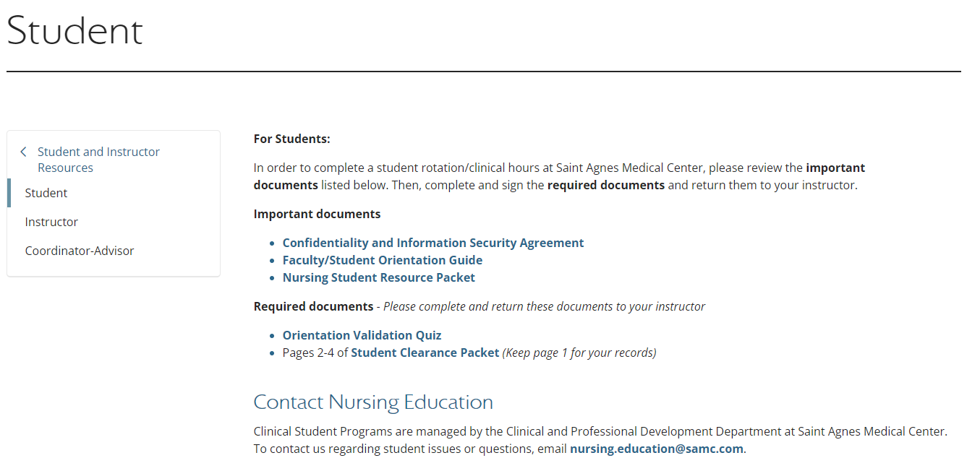
Student Resources Tab
Using your class time wisely will decrease the amount of work you need to complete at home.
Please record your first and last name on all of your assignments.
Completed assignments should be turned in to the tray on the table in the front of the room.
Assignments will be graded and returned to you each Friday.
This is where students will find their clearance packet and associated resources

Slide 12
Requirements
Student Roster
Complio/American Databank is preferred
Required to always be current
If using paper version of roster, vaccine titers to be indicated by “Date +”
No longer require covid vaccine documentation
Student Clearance Packet/ Orientation Quiz
Required to submit annually in Fall semester
May resubmit same documents in subsequent semesters (Spring, Summer) as long as the information is up to date
Valid for one year period

Slide 13
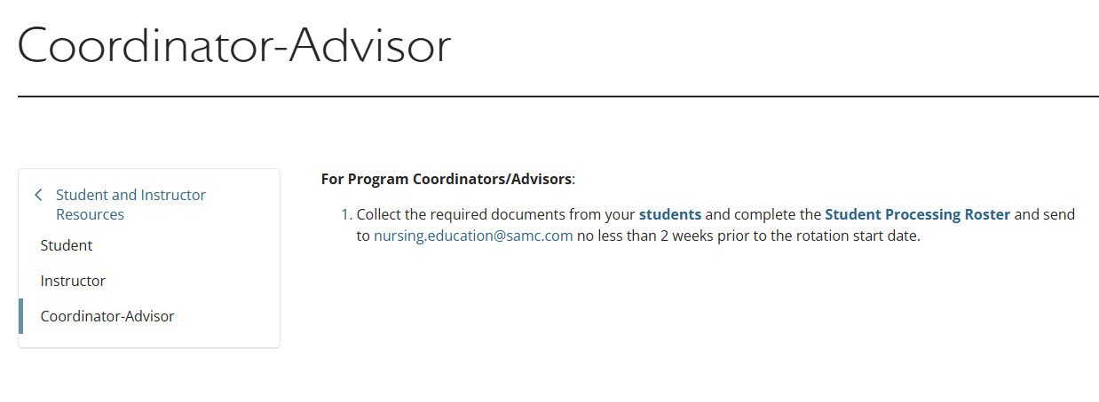
Program Coordinator Resources Tab
This is where program coordinators can find the student processing roster

Slide 14
Program Coordinator Requirements
Email all completed documents in one group email to nursing.education@samc.com
Please place the CCPS # AND the Complio ID in the subject of the email
Do NOT send individual vaccine records or titer results. The date on the roster verifies the information to be true
Do NOT ask your students to send information directly

Slide 15
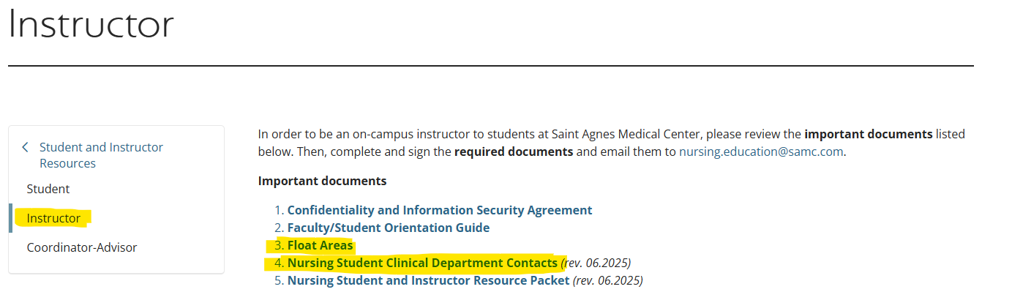
Additional Resources on Website
Float Areas
This document lists which approved float areas your students can go to based on your assigned home unit
Nursing Clinical Department Contacts
Contacts for each nursing unit and float area
Instructors must send an email to the float area manager/educator with their schedule for the rotation showing which students will be floating to specific areas

Slide 16
Approval Process
Approval Process
All students/instructor for each class must be cleared using complio/roster, clearance packet and orientation quiz.
We do not partially clear groups
Documents must be received three weeks prior to start date or accesses may be delayed

Slide 17
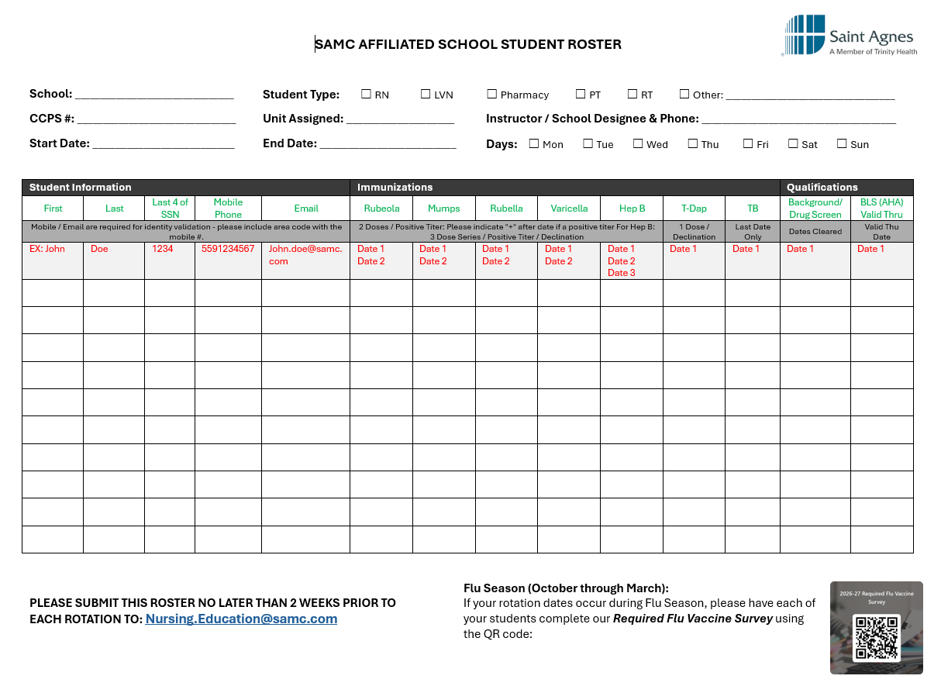
Student Processing Roster

Slide 18

Flu Vaccine
Flu Season is October through March
  We can accept your vaccine as early as August 1st
If your rotation dates occur during Flu Season, please have each of your students complete our Required Flu Vaccine Survey using the QR code:
The QR code is available on the student roster as well

Slide 19
General Badge Info
School badge is always required
OB students will need a SAMC badge to obtain access to those units
Other students will not receive a SAMC student badge

Slide 20
Employee FAQs
If the instructor or student are also an employee, they are not to use their employee badge during clinical hours to gain access to rooms...
Employees are not to do work in their job role during clinical hours
When logging into EPIC, ensure you are using the student role (not your employee role)

Slide 21
EHR Access Process - Updated
Once students/instructors are cleared, then our team requests network access (Turn around time for this process is approximately 3 weeks)
Once we hear back from our system office that your account has been created, we do a few things:
  Enterprise Team will load the Epic e-learning to everyone's HealthStream account
  We will send a Network Access form to the Instructor with everyone's Network ID, initial password and Healthstream ID & Password

Slide 22
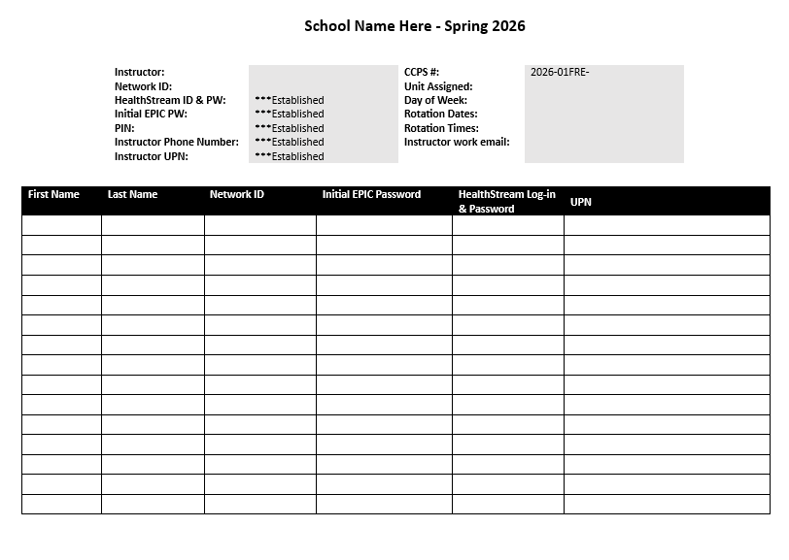
Student Network Access Form
Instructor info is at the top
Student info will be in the rows below

Slide 23
Steps to Obtaining Epic Access
Secure Your Network Account
New students/instructors: Will log into a SAMC computer using the provided 4x4 Network ID from above. This must be done within 60 days, or the account will become inactive.
Log in to a SAMC computer using the provided Network ID and Initial Epic Password
You will be prompted to change your password.
Returning students/Faculty: Do not need to re-secure your account. Will use the same login credentials already provided during previous rotation.
Instructors & Students who are current employees: Will use your employee network ID or HealthStream ID. When logging into Epic, you will choose your student role (not your employee role) while using the EHR.

Slide 24
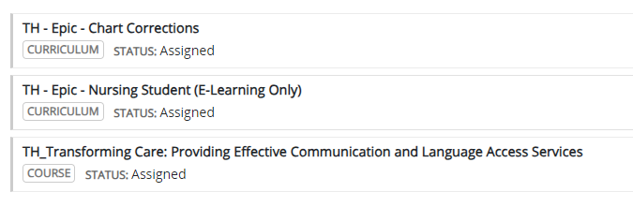
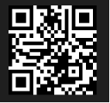
Steps to Obtaining Epic Access
Complete your eLearning via HealthStream:
Go to the link: Welcome to HealthStream (or scan the QR code)
Enter your HealthStream log in & Password to log in (both are the same, initially)
You will be prompted to change your password. Once you change your password, you will need to log in again with your new password.
Complete your assignments on your To-Do list.

Slide 25
Steps to Obtaining Epic Access
Submit a ServiceNow ticket to Unlock Your Epic Access
Once you have completed your eLearning, go to the ServiceNow ticket form by following this link: Delegated Health Ministry Role Base Request - TIS Service Portal (service-now.com). You must be on a SAMC computer for this part.
Type of Request: Select “Login Block Removal”
User: Enter Your Name (The manager and location will automatically populate).
Preferred Contact Method: Choose whether you prefer phone or email and provide your contact details.
Description of Request: Enter “Epic unblock needed.”
Needed By: Enter the date your access is needed by.
Select Add to Cart – Then, in the top right corner, select your cart and then select “Proceed to check out.”
Enter your mobile number, then select “Checkout.”
Your Epic access should become available within the next 1-3 business days.

Slide 26
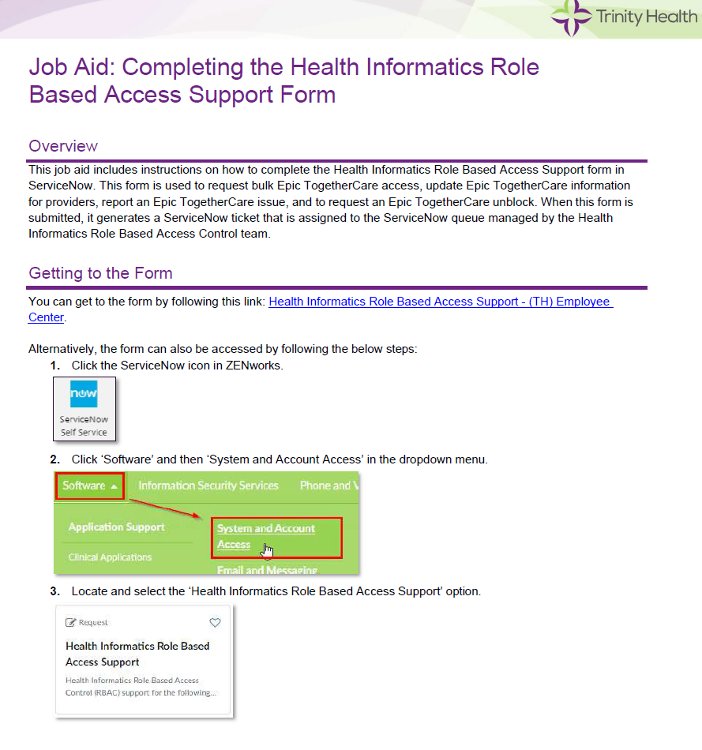
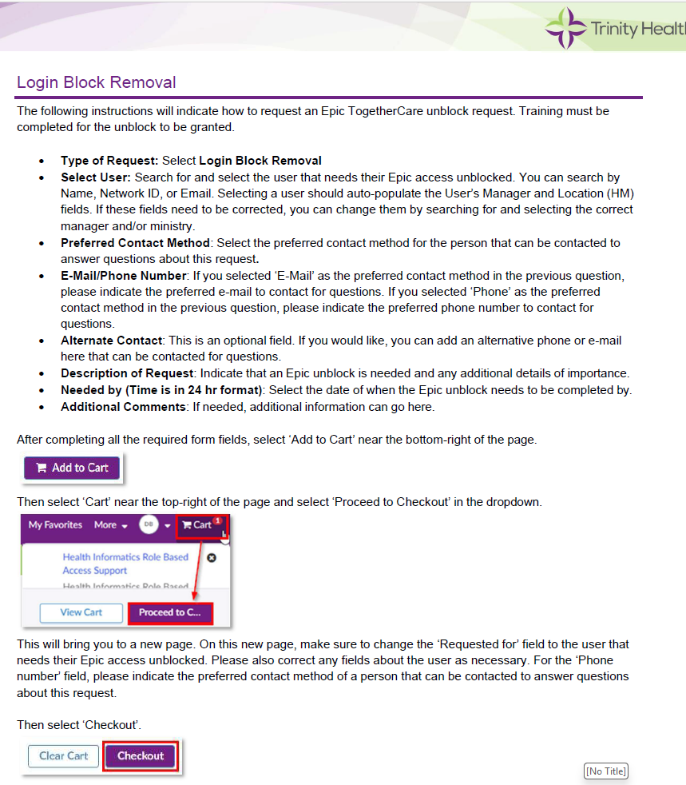
Job Aid for Epic Unblock

Slide 27
Password Recovery
Students and faculty who have forgotten their password must go through the Service Desk (By calling 559-450-3200 or using hospital phone dial 5-3200) and will be asked a series of questions to positively ID them before changing the password.
The mobile number entry is meant to make Service Desk assisted password resets easier and will only be used for such.
You may be asked to go into the Microsoft Account Portal to secure your account if there are issues with logging in.

Slide 28
EHR Access for Instructors - NEW
Instructors who would like to take the in-person virtual class:
  Inpatient RN Epic Training Classes are offered weekly on Wednesday from 0645 to 1600.
  Completion of in person class & e-learning would be required
  Full inpatient RN access would be granted
  No preceptor RN sign off is required
Instructors who are interested – please contact nursing.education@samc.com for registration

Slide 29
EHR Access for Instructors – SAMC Employees
  You have already attended Epic training & completed e-learning
  You will be allowed to use your inpatient access (as you do when working as an employee)
  You must make a progress note for any chart you work in during instructor shifts notating “Working in role of Nursing instructor on this day (list day & time)”
  You log in using your current network ID & password

Slide 30
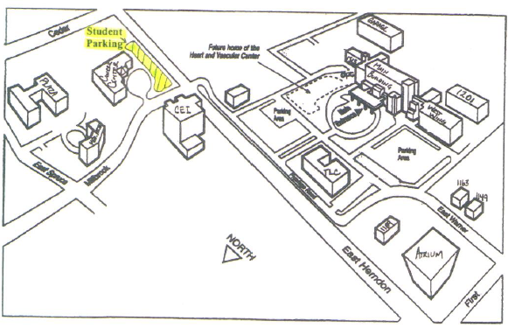
Clinical Day
Designated student and instructor Parking is located at Herndon/Millbrook (NE corner) parking lot in front of C-Care, close to Herndon
  Encourage carpooling and crossing Herndon in packs
No parking on campus is allowed
Obtain parking stickers from Public Safety (1149 building on East Warner). Provide vehicle make/model & License plate #
Place sticker on the bottom right of the rear windshield, on the outside

Slide 31
Clinical Day
Everyone must enter the facility through a Patient/Visitor entrance. Metal Detector scanning is performed when entering.
  1 North
  2 North
  1 West
N95 Fit Testing is required
  The mask ID is required on the processing roster
  Students must bring the N95 that they have been fitted for, in the event they need it
SAMC will provide procedural masks/face shields as needed
Students will wear their school issued uniform and badge at all times

Slide 32
Clinical Day
No more than 10 students are allowed per clinical group.
If your group has more than 10 students, you will need to find them something else to do during the clinical day (stay on school campus, virtual study, etc.)
There will be some instances where you will need to “buddy up” 2 students with 1 RN, or potentially 1LVN student and 1 RN student with 1 preceptor.

Slide 33
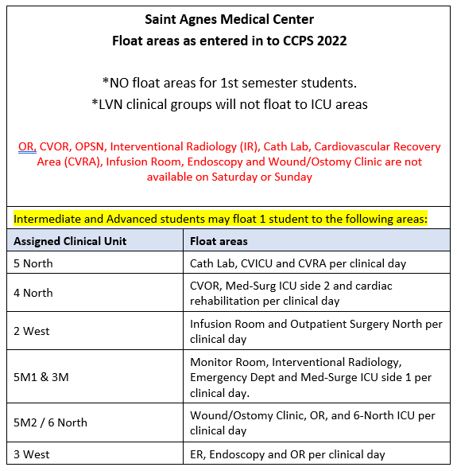
Float Areas
Instructors do not get to pick the float locations. This configuration is due to the changes that came with the new CCPS system.
IF you are an employee, you do not get to pull favors/rank and send students to areas not assigned.
IF a float location is required due to the course objectives, contact Maria.

Slide 34
Clinical Day
Breaks
  Students may take breaks in designated areas
  And do not gather in the cafeteria or break room in large groups
Most units at SAMC cannot accommodate post-conference
  If there is a location on your home unit where you would like to have post-conference, please request permission from the unit manager
  Otherwise, conduct your post-conference off SAMC campus (school campus, zoom, etc.)

Slide 35


Student/
Instructor Injury
If a student is injured during clinical time
  Notify Maria immediately (559) 450-3226 or maria.sanchez@samc.com
    If blood borne pathogen exposure, provide location, patient MRN, details about what happened
  Notify your school administrator/faculty
  Follow your school process
  We are not able to see your student in our Employee Health Department due to not having an employer relationship.
  If needed, take student to Emergency Department or Urgent Care

Slide 36
Evaluations
Please have students fill out evaluations at the end of their clinical experience
Evaluations will be provided on the SAMC webpage
Scan and email them to nursing.education@samc.com or drop them off with Maria or one of the other educators.

Slide 37
Reminders
Please use our shared email for communications about clinical groups, students and instructors
Nursing.education@samc.com
Please avoid emailing the central education team directly. If one of our team members is out of office, we cannot track down your emails outside of the shared email box.
This also allows for less emails and our ability to respond quicker.

Slide 38

We are committed to making the student and instructor experience the best it can be
IF you are experiencing issues or challenges, please contact Maria immediately
Thank you for your engagement and cooperation to make these updates smooth and easy
Thank you for sharing your feedback

Slide 39
What Questions Do You Have?
Please send your questions or feedback to our shared email: nursing.education@samc.com

